Slide 1
<No Code>
The Distributed Medical Device: A Game-Changing Architecture for Medical Devices
©2022 BioT Medical - All rights reserved
Notes:
At BioT, we provide a unique cloud platform for medical devices, allowing a significant portion of the device functionality to be executed on the cloud rather than on the edge hardware. We call this architecture a ‘distributed medical device.’ We believe it's a game changer because such devices are slimmer, more affordable and therefore can scale to the homes of patients, where we believe the future is.
Before diving into the details of it I believe a quick company background is in order
https://docs.google.com/document/d/1hGErn4RNAtzsAHnaB_ga12bprOfCDlG-veXIDBgOCTY/edit

Slide 2
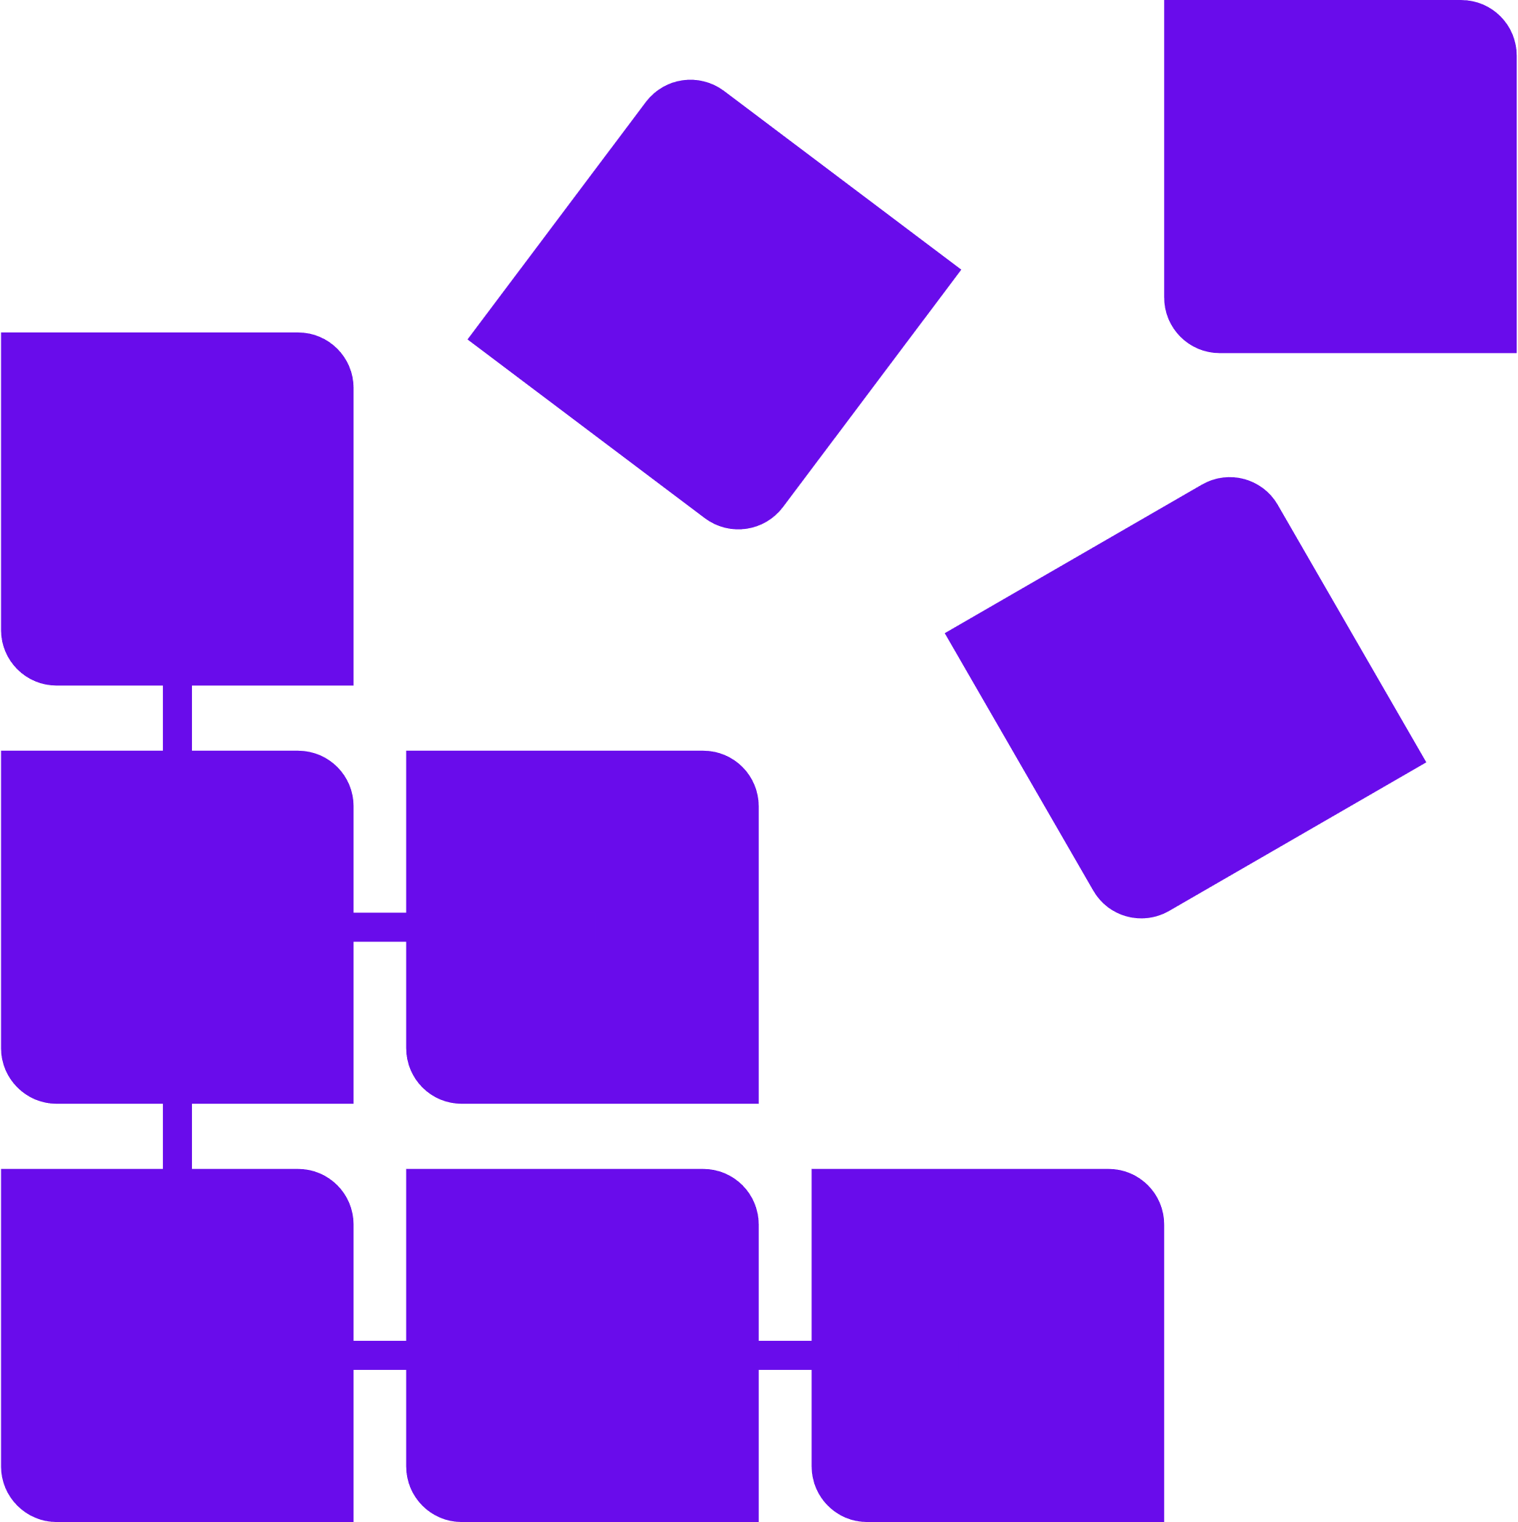
Question 1
Remote care is the future of medicine. Large sets of diagnostics, monitoring and treatment capabilities are available today only in hospitals and will soon be available for home use. What new challenges do you think device manufacturers will face in a connected care world?

Slide 3
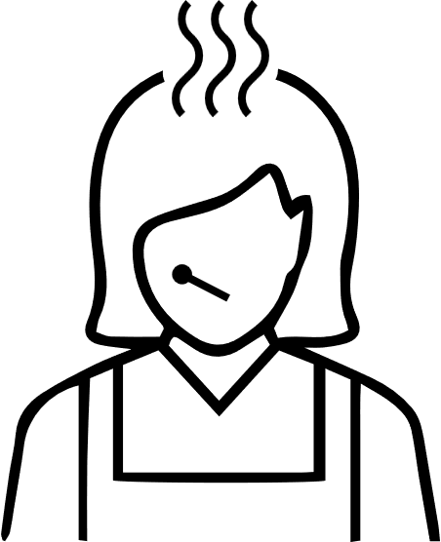
Home Care Introduces New Challenges
Ms of patients & Ms of homes
Device Cost
Device Capabilities
I want some drawing here that illustrates evolving device capabilities when it is already in the house – for example start with a small house with a device logo and just one or two logos for biomarkers around it and move to bigger house with the same device but more biomarkers around it
Notes:
BioT provides a cloud platform for manufacturers of medical devices, which transforms them into a distributed medical device, where a major part of the device is on the cloud. For example, algorithm execution, device management, as well as provider-facing capabilities like RPM and EHR-integration.
Our crown jewel is a breakthrough NoCode self-service interface that enables the transformation while freeing our customers from coding, DevOps and Professional Service with unknown charges down the line.

Slide 4
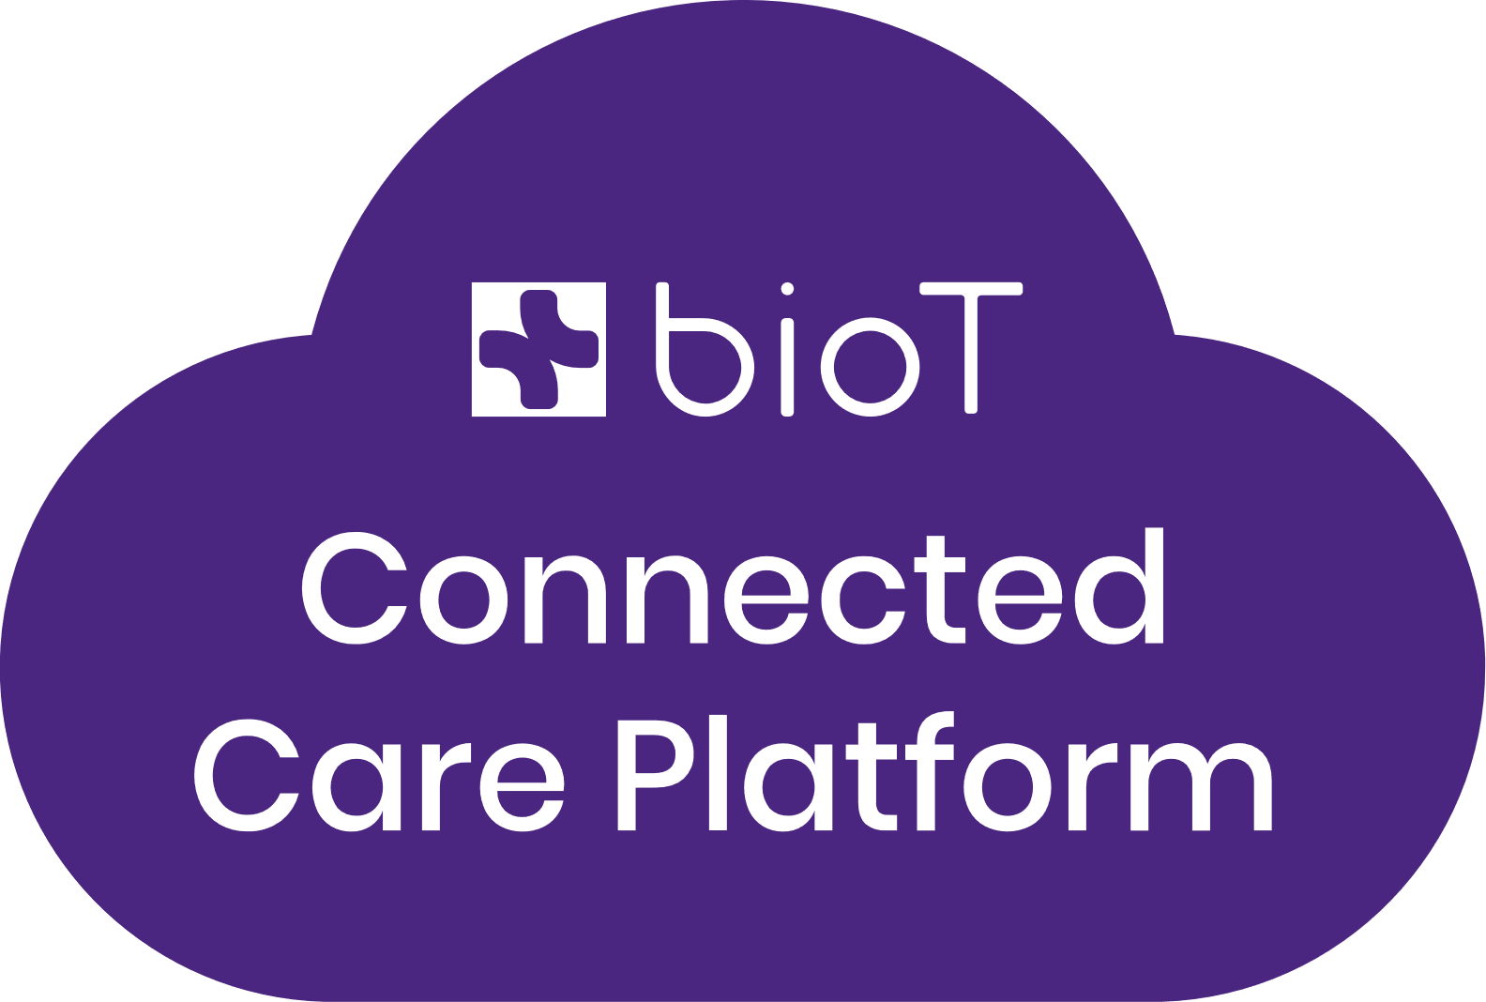
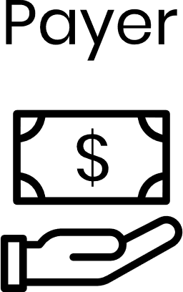
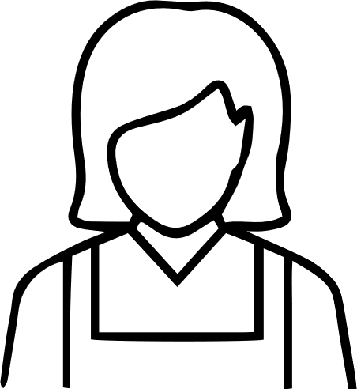
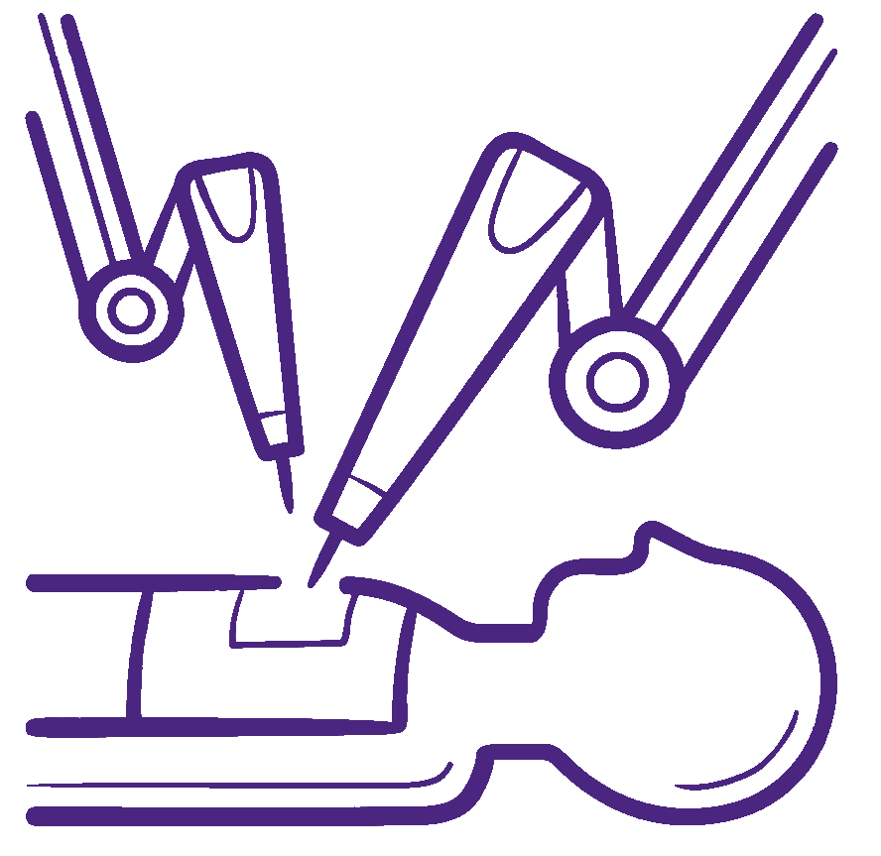
Growing Plethora of Use Cases Spanning the Entire Device Lifecycle
Clinical Trial
Market – Patient Outcome
Market - Revenue
Remote patient monitoring – continuous and spot
Patient engagement & PROM questionnaires
Safety & pharmacovigilance
Emergency management
Adherence
PMCF follow-up
Efficacy analysis
Automated reimbursement by RPM / RTM CPT codes
Pay-per-use – post or pre-paid
Remote device maintenance
Notes:
Before diving into the internals of BioT let’s go over some use cases supported out of the box in BioT

Slide 5
Question 2
It seems like connecting devices to a cloud is a given but something more is needed to truly open the possibilities of home care and design devices for hospital at home use. What is the evolution medical devices need to go through to make them best suited for home care

Slide 6
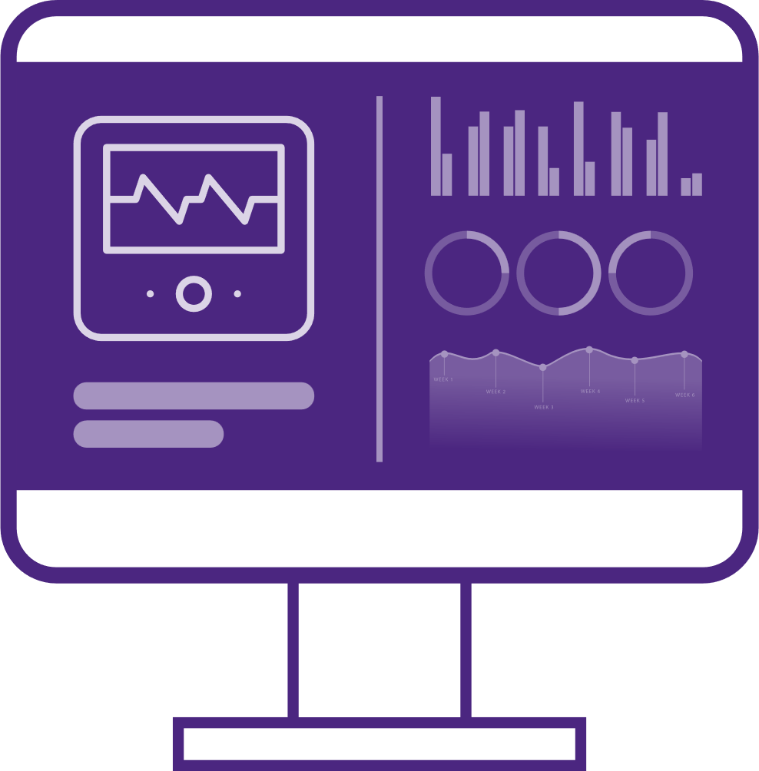
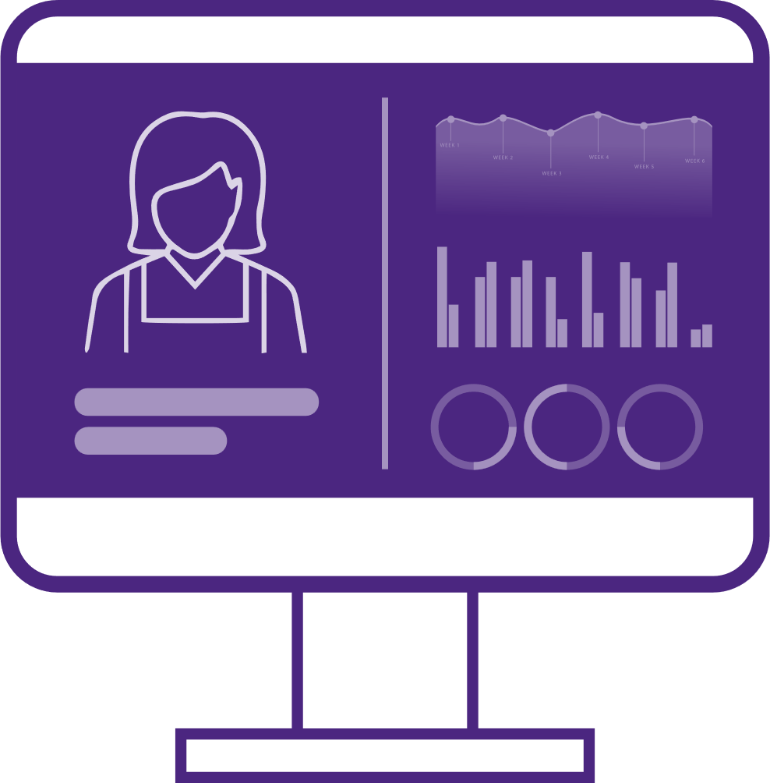
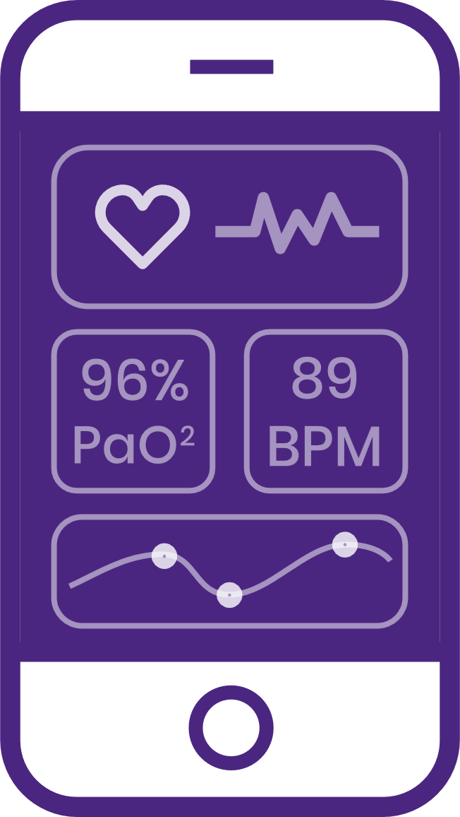
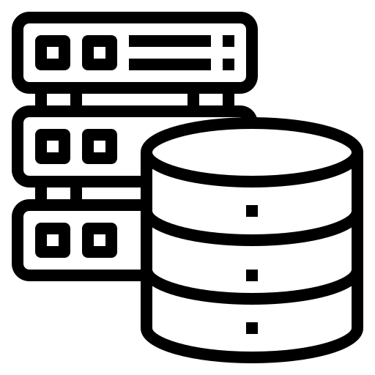
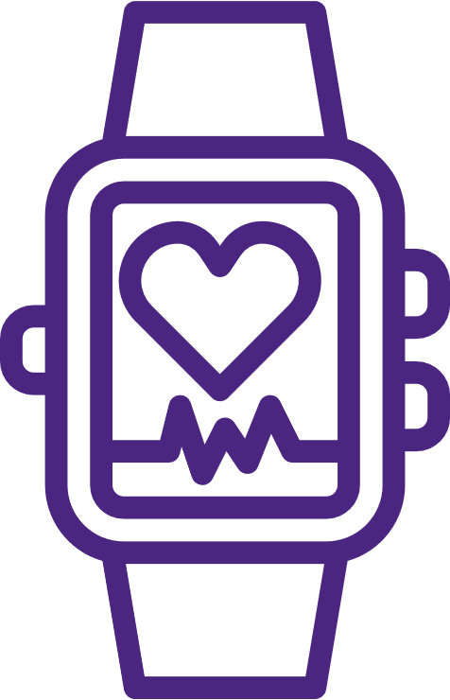
Medical Devices Need to Become Distributed
Manufacturer
From monolithic cloud-supported to flexible, cloud-based, intelligent applications
Extend the definition of device – not a machine but a set of evolving capabilities
Modular & personalized
Extendable medical capabilities with collaborations
Code
Data
Workflows
Patient
Clinicians
Clinics
Clinicians
Manufacturer
Device Manufacturers
Patient
Clinics
Outcome Analysis
Device management
Algorithm providers
Workflows
Clinical insights
Device collaboration
Pharma
Algorithms on demand
Alerts/Alarms
Remote patient monitoring
Community
Notes:
BioT provides a cloud platform for manufacturers of medical devices, which transforms them into a distributed medical device, where a major part of the device is on the cloud. For example, algorithm execution, device management, as well as provider-facing capabilities like RPM and EHR-integration.
Our crown jewel is a breakthrough NoCode self-service interface that enables the transformation while freeing our customers from coding, DevOps and Professional Service with unknown charges down the line.

Slide 7
The Future of Medical Devices is Distributed
Device responsibility
Interact with patient’s body
Exchange raw data with cloud
Cloud responsibility
Activation & Authentication
Compute - Signal processing, algorithms, etc.
Store – raw, biomarkers, log files
Embed – workflows & algorithms
Edge device management – integrity, validation, operations
Cybersecurity
Collaboration with eco-system
Code (bring partners algorithms)
Data
Workflows
Notes:
Abstract:
We are rapidly approaching a world where being part of the Internet of Medical Things (IoMT) is a necessity for all medical devices. By executing a major part of their functionality on the cloud rather than on the edge hardware , these ‘distributed’ medical devices open up new horizons in healthcare and life science. These horizons include present benefits such as optimized device costs, overall quality, and product innovation speed, as well as future ones, like enabling doctors to prescribe algorithms to their patients. However, nothing comes without a tradeoff. Challenges like cloud change-control and others rise and have a toll. In this session we will review: - What a distributed medical device is and the role of the cloud in the architecture - Why this architecture is a game changer in terms of device costs, overall quality, and product innovation speed - New patient outcomes enabled by distributed medical devices - Challenges and limitations of Distributed Medical Devices - Maintaining privacy, cybersecurity, and regulatory compliance in a distributed medical device - Technologies for accelerating the development of distributed medical devices - A case study of a distributed medical device
The problem:
The biggest trend in medical devices today is adapting them to home use in order to support the already forming tectonic transition to hospital-at-home due to the global crisis of healthcare systems. Today's healthcare systems simply cannot add more beds, and have been proven to do more damage to patient health than good in too many cases.
To support the hospital-at-home, medical devices must be provided to the homes of patients in their Millions, and be connected to the cloud.
However, the majority of today's medical devices are usually costly and cumbersome, and therefore cannot scale well to the homes of people. Medical device manufacturers must think differently about architecting them at an affordable bill-of-material cost while keeping their ongoing cloud operation costs at minimum. In addition, they have to allow for continuous evolution of device capabilities easily - there's no way a technician would go to the home of the patient to do or assist with a firmware upgrade.
A 'distributed medical device' is an architecture that enables medical device solutions than can scale to the home.

Slide 8
Question 3
Now we understand what a distributed architecture is; what are the benefits of such architecture? Does it really answer the challenges previously mentioned?

Slide 9
The Benefits of Distributed Architecture
Clinicians
Manufacturer
Device Manufacturers
Patient
Clinics
Outcome Analysis
Device management
Algorithm providers
Workflows
Clinical insights
Algorithms on demand
Alerts/Alarms
Device collaboration
Pharma
RPMS
RPMs
Community
Improved Outcomes
Cost Reduction
Flexibility
Collaboration
Improved medical insights
RT & long term data availability
Data from partners & collaborations
Rapid product innovations
Short cycles to introduce new capabilities
Data for analysis
Edge device hardware
Operations (refurbishing, replacements, support, etc.)
Security – key know-how is not on the device; easier to secure
Capabilities not restricted by processing
Instantaneous introduction of new capabilities – no need to update Ms of devices
New charging models
Pay per use
Subscription
Per capability
Easy collaboration without exposing know-how
Algo sharing without risking IP
Creating cross vendor workflows
Improving quality – continuous collaboration with QMS
Notes:
BioT provides a cloud platform for manufacturers of medical devices, which transforms them into a distributed medical device, where a major part of the device is on the cloud. For example, algorithm execution, device management, as well as provider-facing capabilities like RPM and EHR-integration.
Our crown jewel is a breakthrough NoCode self-service interface that enables the transformation while freeing our customers from coding, DevOps and Professional Service with unknown charges down the line.

Slide 10
Question 4
When considering building distributed architecture: What should device manufacturers consider? What challenges must be addressed in order to make sure that the architecture they design actually fulfills the needs?

Slide 11
Challenges Designing a Future-Proof Distributed Architecture
Extensive capability set required even for a basic product
Continuous evolution of device data model
Workflows, changes and evolution
Seamless updates
Evolving eco-system collaboration
Cyber security & regulation compliance and evolution
Clinician Portal
Manufacturer Portal
Mobile App
Clinician Workspace
Manufacturer Workspace
External UX integration
Billing
UX Tools
Workflow Management
Alerts/Alarms
EHR
Workflow Tools
Eco-system Integration
Clinical Insights
Algorithmic Plug-In
Device Management
RPM
Data Infra
structure
Connectivity
Cyber Security
Privacy
Data Management
Years to A Field Ready System
Medical Device
Notes:
Teach BioT about your devices using a drag & drop console, and reduce the time to build from a year to one day!

Slide 12
Question 5
Apparently seamless updates are some of the key considerations – how is this different from FOTA and why is this a challenge?

Slide 13
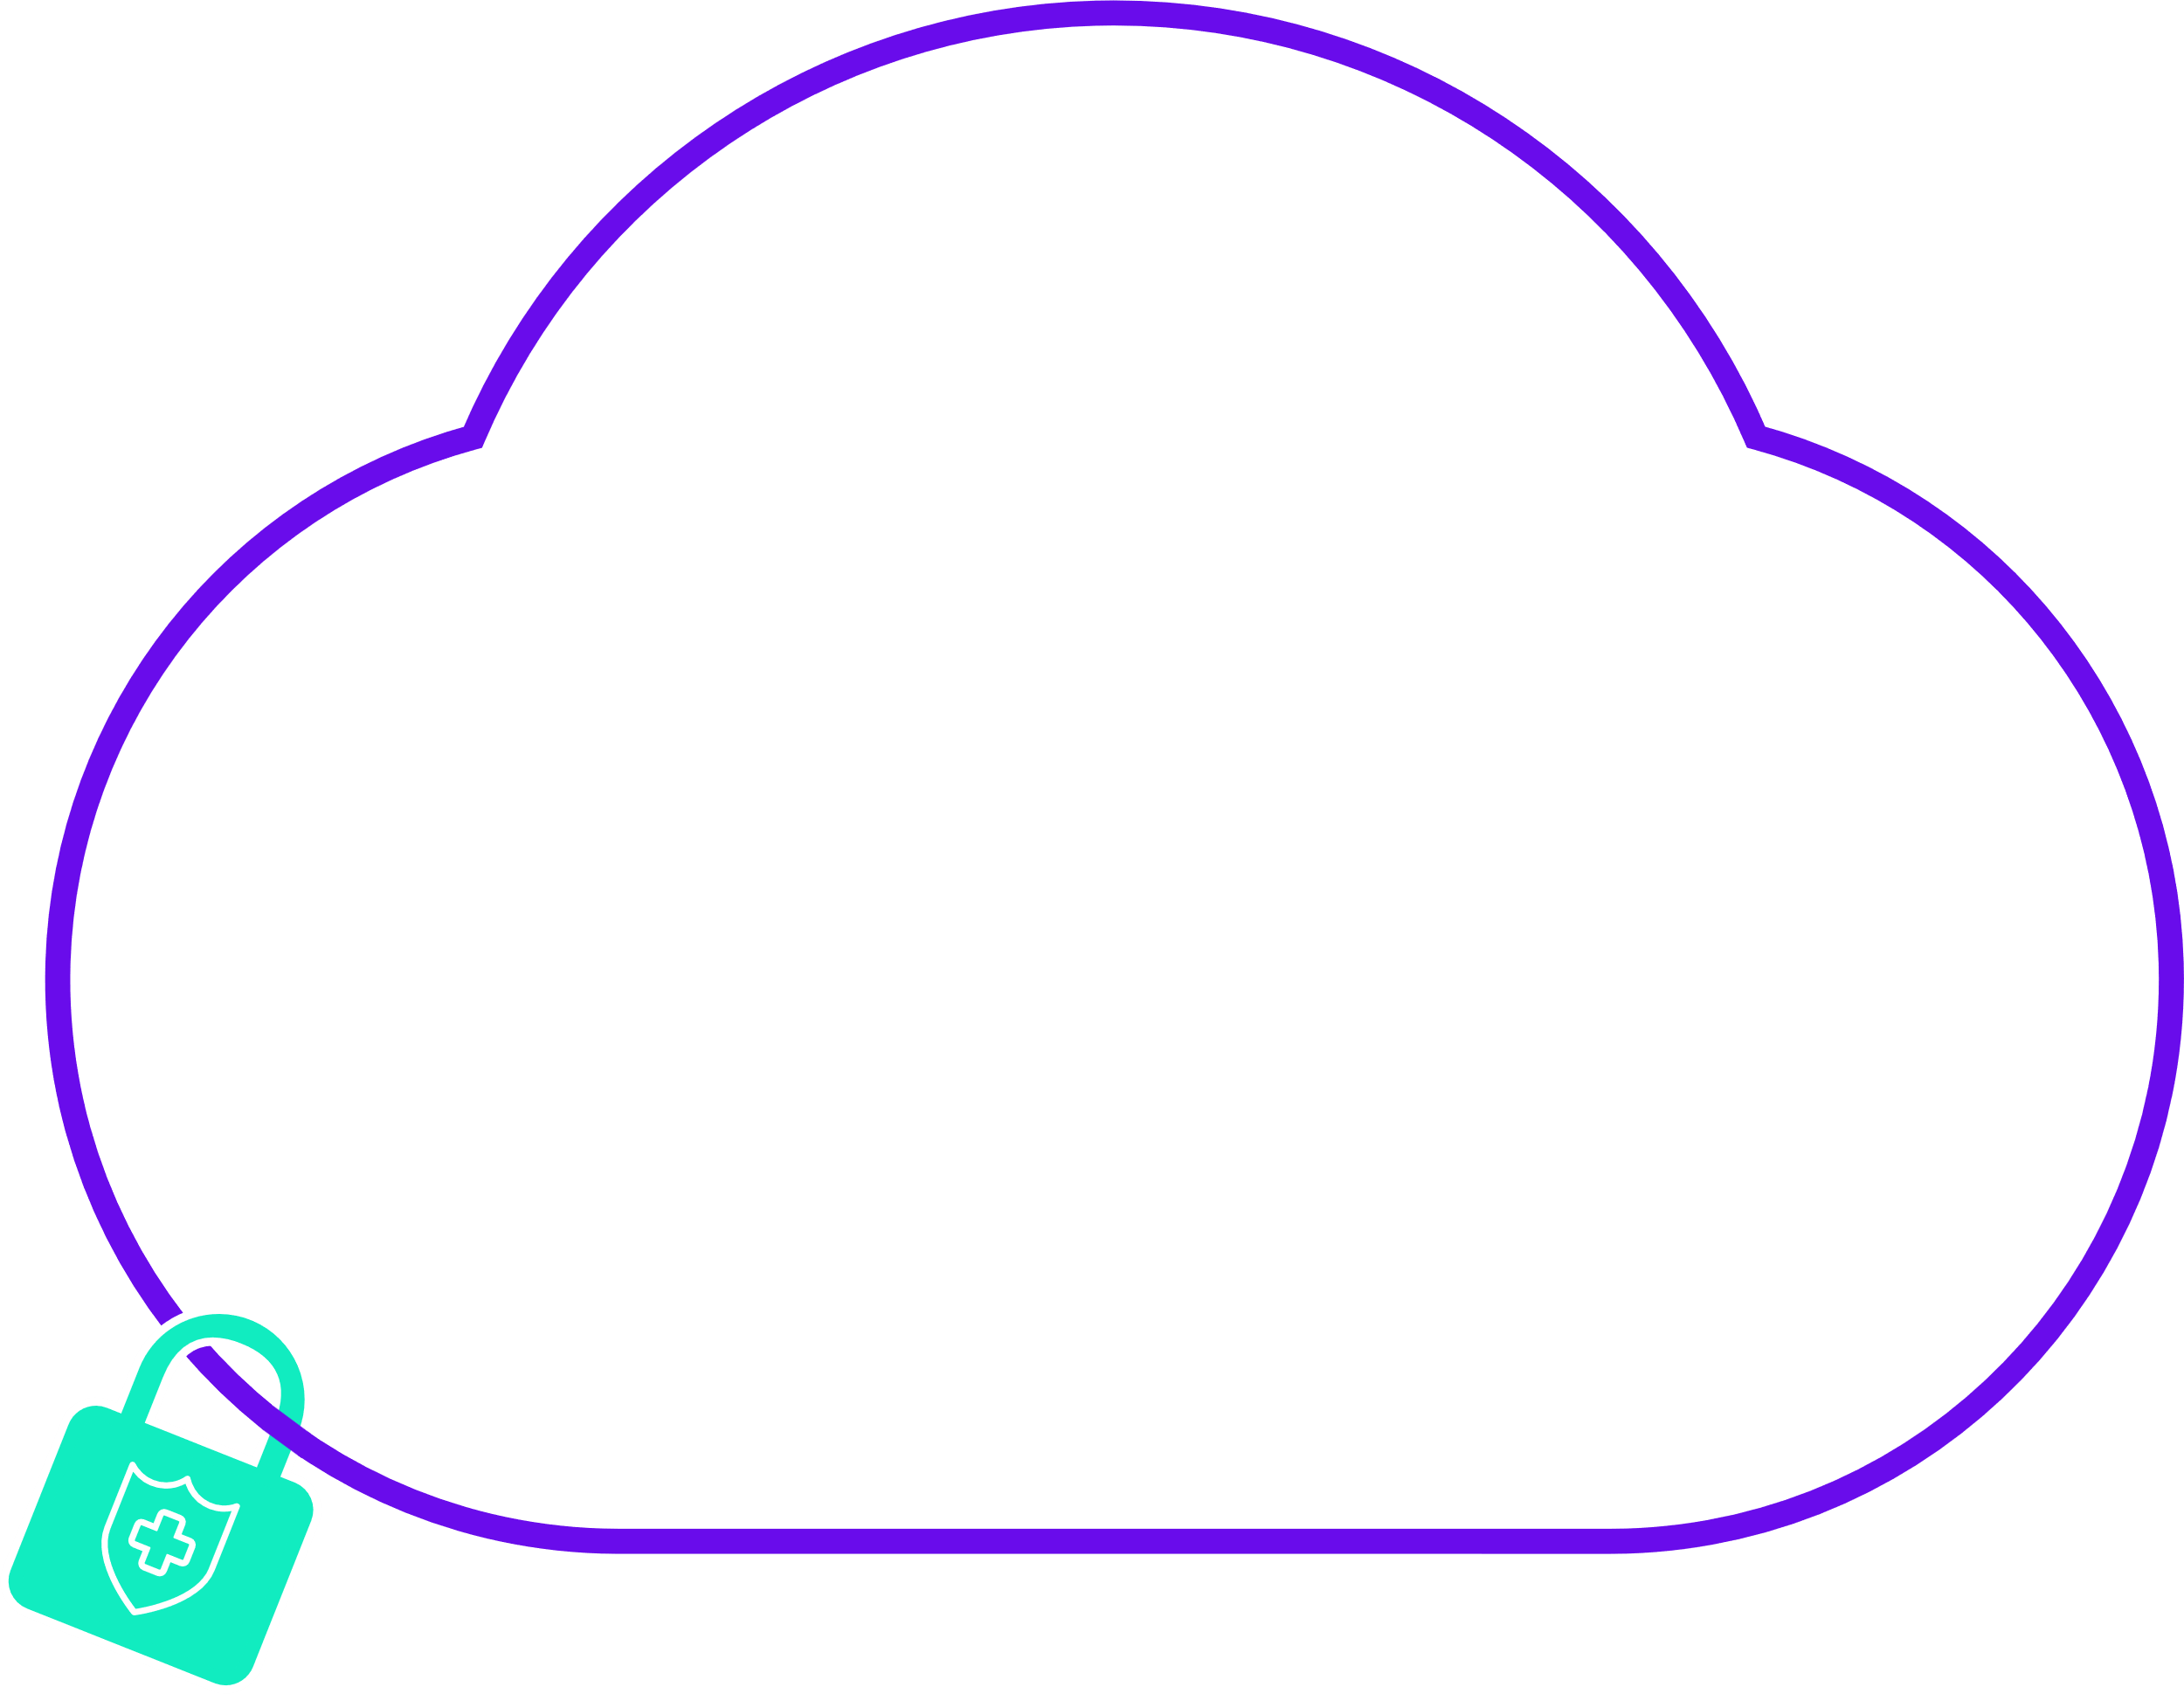
From FOTA to Cloud Updates: Benefits & Challenges
Manufacturer Portal
Benefits
FOTA
Clinician Portal
Instant update of all field devices
No patient intervention
Reduces retrofits
Algorithm & Device Capabilities Update In Cloud
Challenges
Allowing code teams on-demand seamless upgrades
Zero cloud understanding
Upgrade
No DevOps
Qualification
Notes:
Our DevOps team monitors the cloud deployments 24*7 – you are exempt from worrying about availability

Slide 14
Question 6
You mentioned the need for continuous evolution of capabilities as well as ever evolving workflows. I would like to dive a bit deeper here. What should you consider when designing for flexibility?

Slide 15
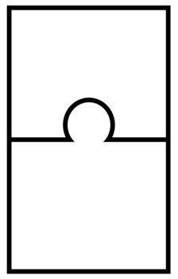
Designing for Flexibility
Trend analysis algorithm
Clinician Visualization
Adjustable workflows
Dynamically hook algorithms – Any algorithm, any flow, any time
Bring code to data, not data to code
Self reliance - remove dependency on IT/DevOps/Cloud dev teams
Cyber security & compliance
Isolate algorithms – prevent security & data breaches
Access control
Patient Historical Data
Insight Algorithm
Clinician Visualization
Clinical Data Collection
Alarm
Alarms Insights
Alarm Management
Flexibility requires the ability to create dynamic workflows and the ability to rapidly introduce your proprietary algorithms into these flows
Notes:
BioT provides a cloud platform for manufacturers of medical devices, which transforms them into a distributed medical device, where a major part of the device is on the cloud. For example, algorithm execution, device management, as well as provider-facing capabilities like RPM and EHR-integration.
Our crown jewel is a breakthrough NoCode self-service interface that enables the transformation while freeing our customers from coding, DevOps and Professional Service with unknown charges down the line.

Slide 16
Question 7
What about cyber security. Are there any special considerations here?

Slide 17
Considerations Designing for Cyber Security & Privacy
PII & PHI protection
ABAC – Attribute-based access control
Auditing and logging without PII/PHI compromise
PII/PHI data leak prevention
Security architecture needs to be part of the design
Microservice segregation, authorization and access controls
Data at rest and data at transit protection
Standards support – LDAP / Active Directory, OAuth2, JWT
Continuous implementation of best practices
Penetration tests and vulnerability assessments
Security patching
Security policy updates
Medical grade cyber security requires years of know-how and is a continuous, high intensity effort
13485
27001
Notes:
If asked why ISO 13485 is here? cybersecurity is considered a part of quality, at least in the eyes of the FDA.

Slide 18
Question 8
So, assume we managed all the challenges mentioned. The world of tomorrow is data driven and in such a world the internal customers need to move fast and independent of other teams. How do you see that happenning?

Slide 19
Reduce Choke Points – Key Design Considerations
Enabling internal clients to build on their own
No code Self-service
Define their own workflows, integrate their algo & change on need
Define & change their own data models
Your design needs to remove dependencies and allow internal customers fast time to product
Notes:
BioT provides a cloud platform for manufacturers of medical devices, which transforms them into a distributed medical device, where a major part of the device is on the cloud. For example, algorithm execution, device management, as well as provider-facing capabilities like RPM and EHR-integration.
Our crown jewel is a breakthrough NoCode self-service interface that enables the transformation while freeing our customers from coding, DevOps and Professional Service with unknown charges down the line.

Slide 20
DYI? Barriers are Very High
Time to build impacted by Compliance & Regulations
Privacy (HIPAA, GDPR, etc.)
Cyber security & Standards (ISO13485, 27001, HITRUST, etc.)
Continuous evolution
Cloud know-how
Dev-ops, data management, connectivity, etc.
Future-Proofing
Design for flexibility – easy introduction of new capabilities
Continuous integration with eco-system (EHR, MDSS, etc.)
Notes:
MedTech and Pharma companies are facing significant challenges when trying to transform their medical devices into a connected care solution
Enabling medical devices for remote use is difficult for several reasons:
Firstly, remote care involves collecting patient data over the Internet, which introduces risk, such as privacy violation and cybersecurity threats. That’s a significant gap most device companies are not able to cope with and solve.
Second, medical device companies are used to building hardware that is operated by professionals. But when addressing home care, they face with patients, which are not professionals. So companies must discover new ways to help them, ways that must be simple, despite being remote.

Slide 21
Question 9
It seems using a platform for building medical devices can help. Can you walk us through what a platform like that should look like and what we need to make sure it is provided?

Slide 22
NoCode Platform for Building Connected Medical Devices
Build device data model & remote workflows through drag & drop
Telemetry, imagery, waveforms, raw data
Plug-in your algorithms for proprietary insights using Lambda functions
Tailor clinician experience
Manage devices & organizations
Research de-identified patient data
Clinician Portal
Manufacturer Portal
Mobile App
Clinician Workspace
Manufacturer Workspace
External UX integration
Billing
UX Tools
Workflow Management
Alerts
Patient Engagement
EHR
Workflow Tools
Eco-system Integration
Clinical Insights
Algorithmic Plug-In
Device Management
RPM
Data Infra
structure
Connectivity
Cyber Security
Privacy
Data Management
Build connected medical devices in one day!
Medical Device
Notes:
Teach BioT about your devices using a drag & drop console, and reduce the time to build from a year to one day!

Slide 23
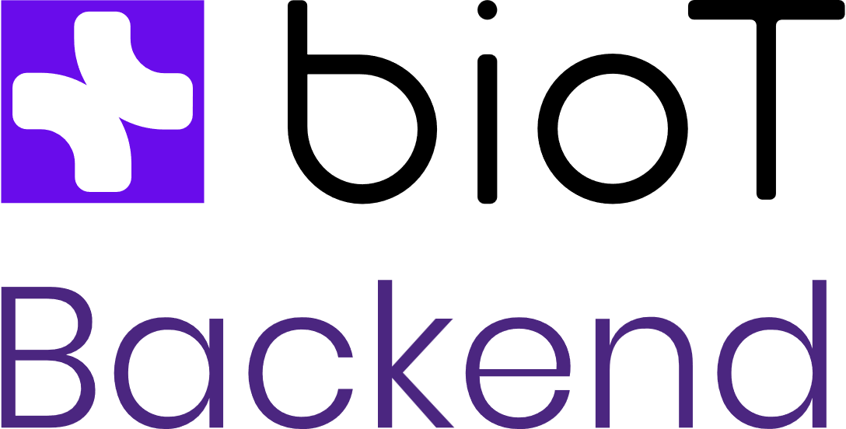
Easy & Flexible to Operate
Manufacturer Portal
Fully managed PaaS with guaranteed 99.9% availability – you don’t need any cloud know-how
Cloud agnostic
Data ownership remains yours
Clinician Portal
Build connected medical devices in one day!
Notes:
Our DevOps team monitors the cloud deployments 24*7 – you are exempt from worrying about availability

Slide 24
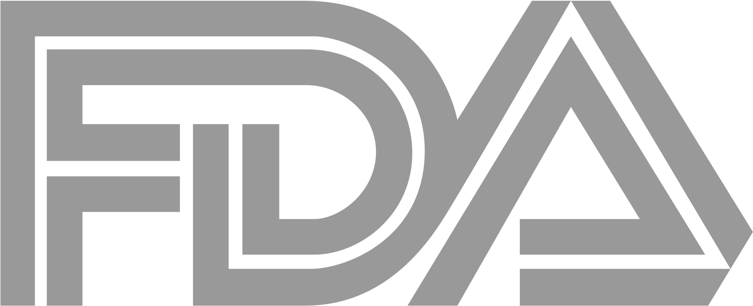
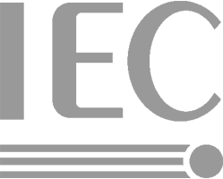
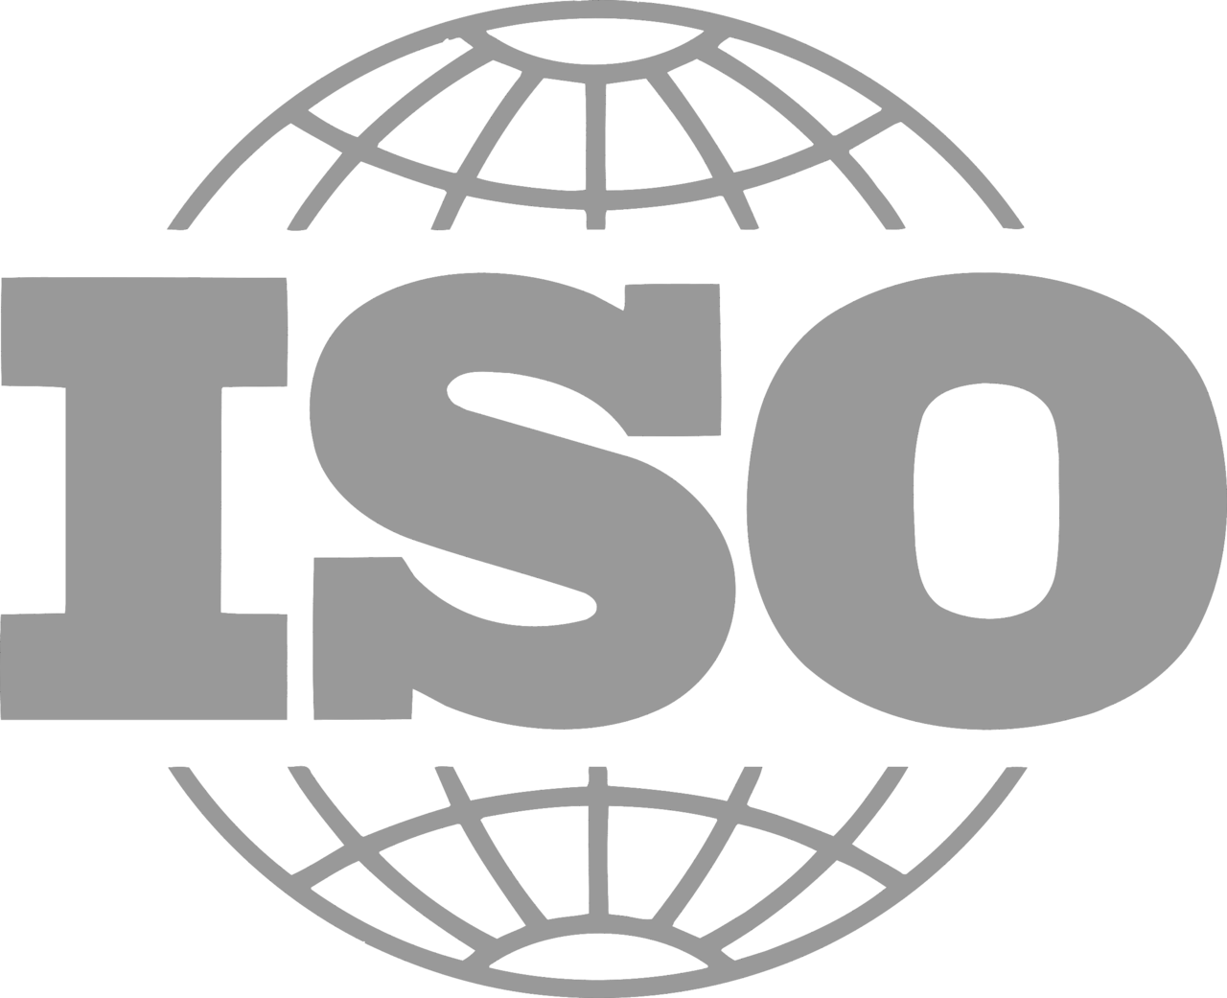
Save Time & Cost Meeting Regulations and Provider Hurdles
Manufacturer Portal
US & EU Regulation-compliant Design History File (DHF)
HIPAA & GDPR compliant
Cyber security design & documentation
Continuous Compliance with MedTech’s quality and information security standards today and tomorrow
Clinician Portal
62304
13485
27001
Build connected medical devices in one day!
Notes:
US & EU Regulation-compliant Design History File (DHF) to accelerate your regulatory processes
Purposed for identifiable patient data. HIPAA & GDPR privacy controls backed up by BAA & DPA to cover privacy liability
Cyber security design and cyber collaterals to satisfy your customers:
Software Bill of Materials (SBOM)
SaaS Bill of Materials (SaaS BOM)
MDS^2 questionnaires
Custom 3rd party risk assessment

Slide 25
Question 10
What would you like our audience to take from this session?

Slide 26
TBD
Summary
Notes:
אחרי דמו. לומר שבעצם log file מומש ככה, ללא שורת קוד. ובצורה דומה במערכת יש מחולל של מודלי דאטה מאוד גמיש ומתאים למרחב ענק של use cases
Remote use – תן דוגמה של שליטה במכונת הנשמה מבלי להכנס לחדר בו היא נמצאת, כמו בקורונה
Also say that the usage history can serve for a pay-per-use business model
Alarm – Tab Clinical alarm in Patient, Triggers if crosses the normal range of observations. Show SPO2 88% min normal range, and the relevant alarm; Show the state - Done / Active
אם שואלים איך הטריגרים עובדים, הסיפור הוא שפלאגין מסתכל על המדידות ואם הן חורגות מהטווח, אז יוצר רשומת alarm וחוץ מזה הוא יכול עכשיו לפנות לכל מערכת חיצונית כדאי להוגיע

Slide 27
Thank You
Visit us: www.biot-med.com
Follow us on LinkedIn
©2022 BioT Medical - All rights reserved

